Slide 1
Analysis of Motion and Forces on Elements
After going through the basic terminologies, conventions and definitions connected to the mechanisms and machines next step is analysing the motion of, and forces on, the elements of a mechanism or machine respectively. The analysis of motion of elements of mechanism is known as kinematic analysis whereas the analysis of forces on elements of machine is known as kinetic/ dynamic analysis.
N.B. Broadly, similar to the share of contact hours between me and Prof SS Roy which is 3:1, the ratio of marks also follow the same pattern. And out of my 75%, kinematics and kinetics will be in the ratio of 37.5% each.

Slide 2
Kinematic (Velocity and Acceleration) Analysis for Elements in Machines
It is sometimes desirable to obtain the results (velocity and acceleration) in the form of mathematical expressions, and some of the simpler mechanisms are amenable to this analytical treatment. In the more complicated mechanisms when such expressions, even if found, would usually be too clumsy to be useful, graphical methods may provide the answers we require more quickly, and in a more illuminating way. We therefore consider examples of both methods.
N.B. A computer based third approach would be taught by Prof SS Roy.

Slide 3
Analytical Method
To illustrate the application of analytical methods we choose the most widely used of all mechanisms, the so-called ‘simple engine mechanism’ or ‘slider crank mechanism’ (it may be noted that though they serve different machines, mechanism-wise they are same). On the basis of our chosen schematic diagram of the mechanism and following usual conventions, the expressions (approximate) for velocity and acceleration of reciprocating slider/piston appear as follows:
ẍ = - ωr{sinθ+(sin2θ)/2n}
and ẍ = - ω²r{cosθ+(cos2θ)/n}
where the notations carry their usual meaning. As in the majority of engines ‘n’ has a value of 3.5 to 4 or more, the third term (if expanded) in the velocity expression is of the order of ½ %, and in the acceleration in the order of 1%, of the first term. Hence the above expressions are reasonably accurate for practical use. Here, it should be noted that if the connecting rod were ‘infinitely’ long we should obtain expressions showing that the piston/slider had simple harmonic motion containing only the first term.

Slide 4
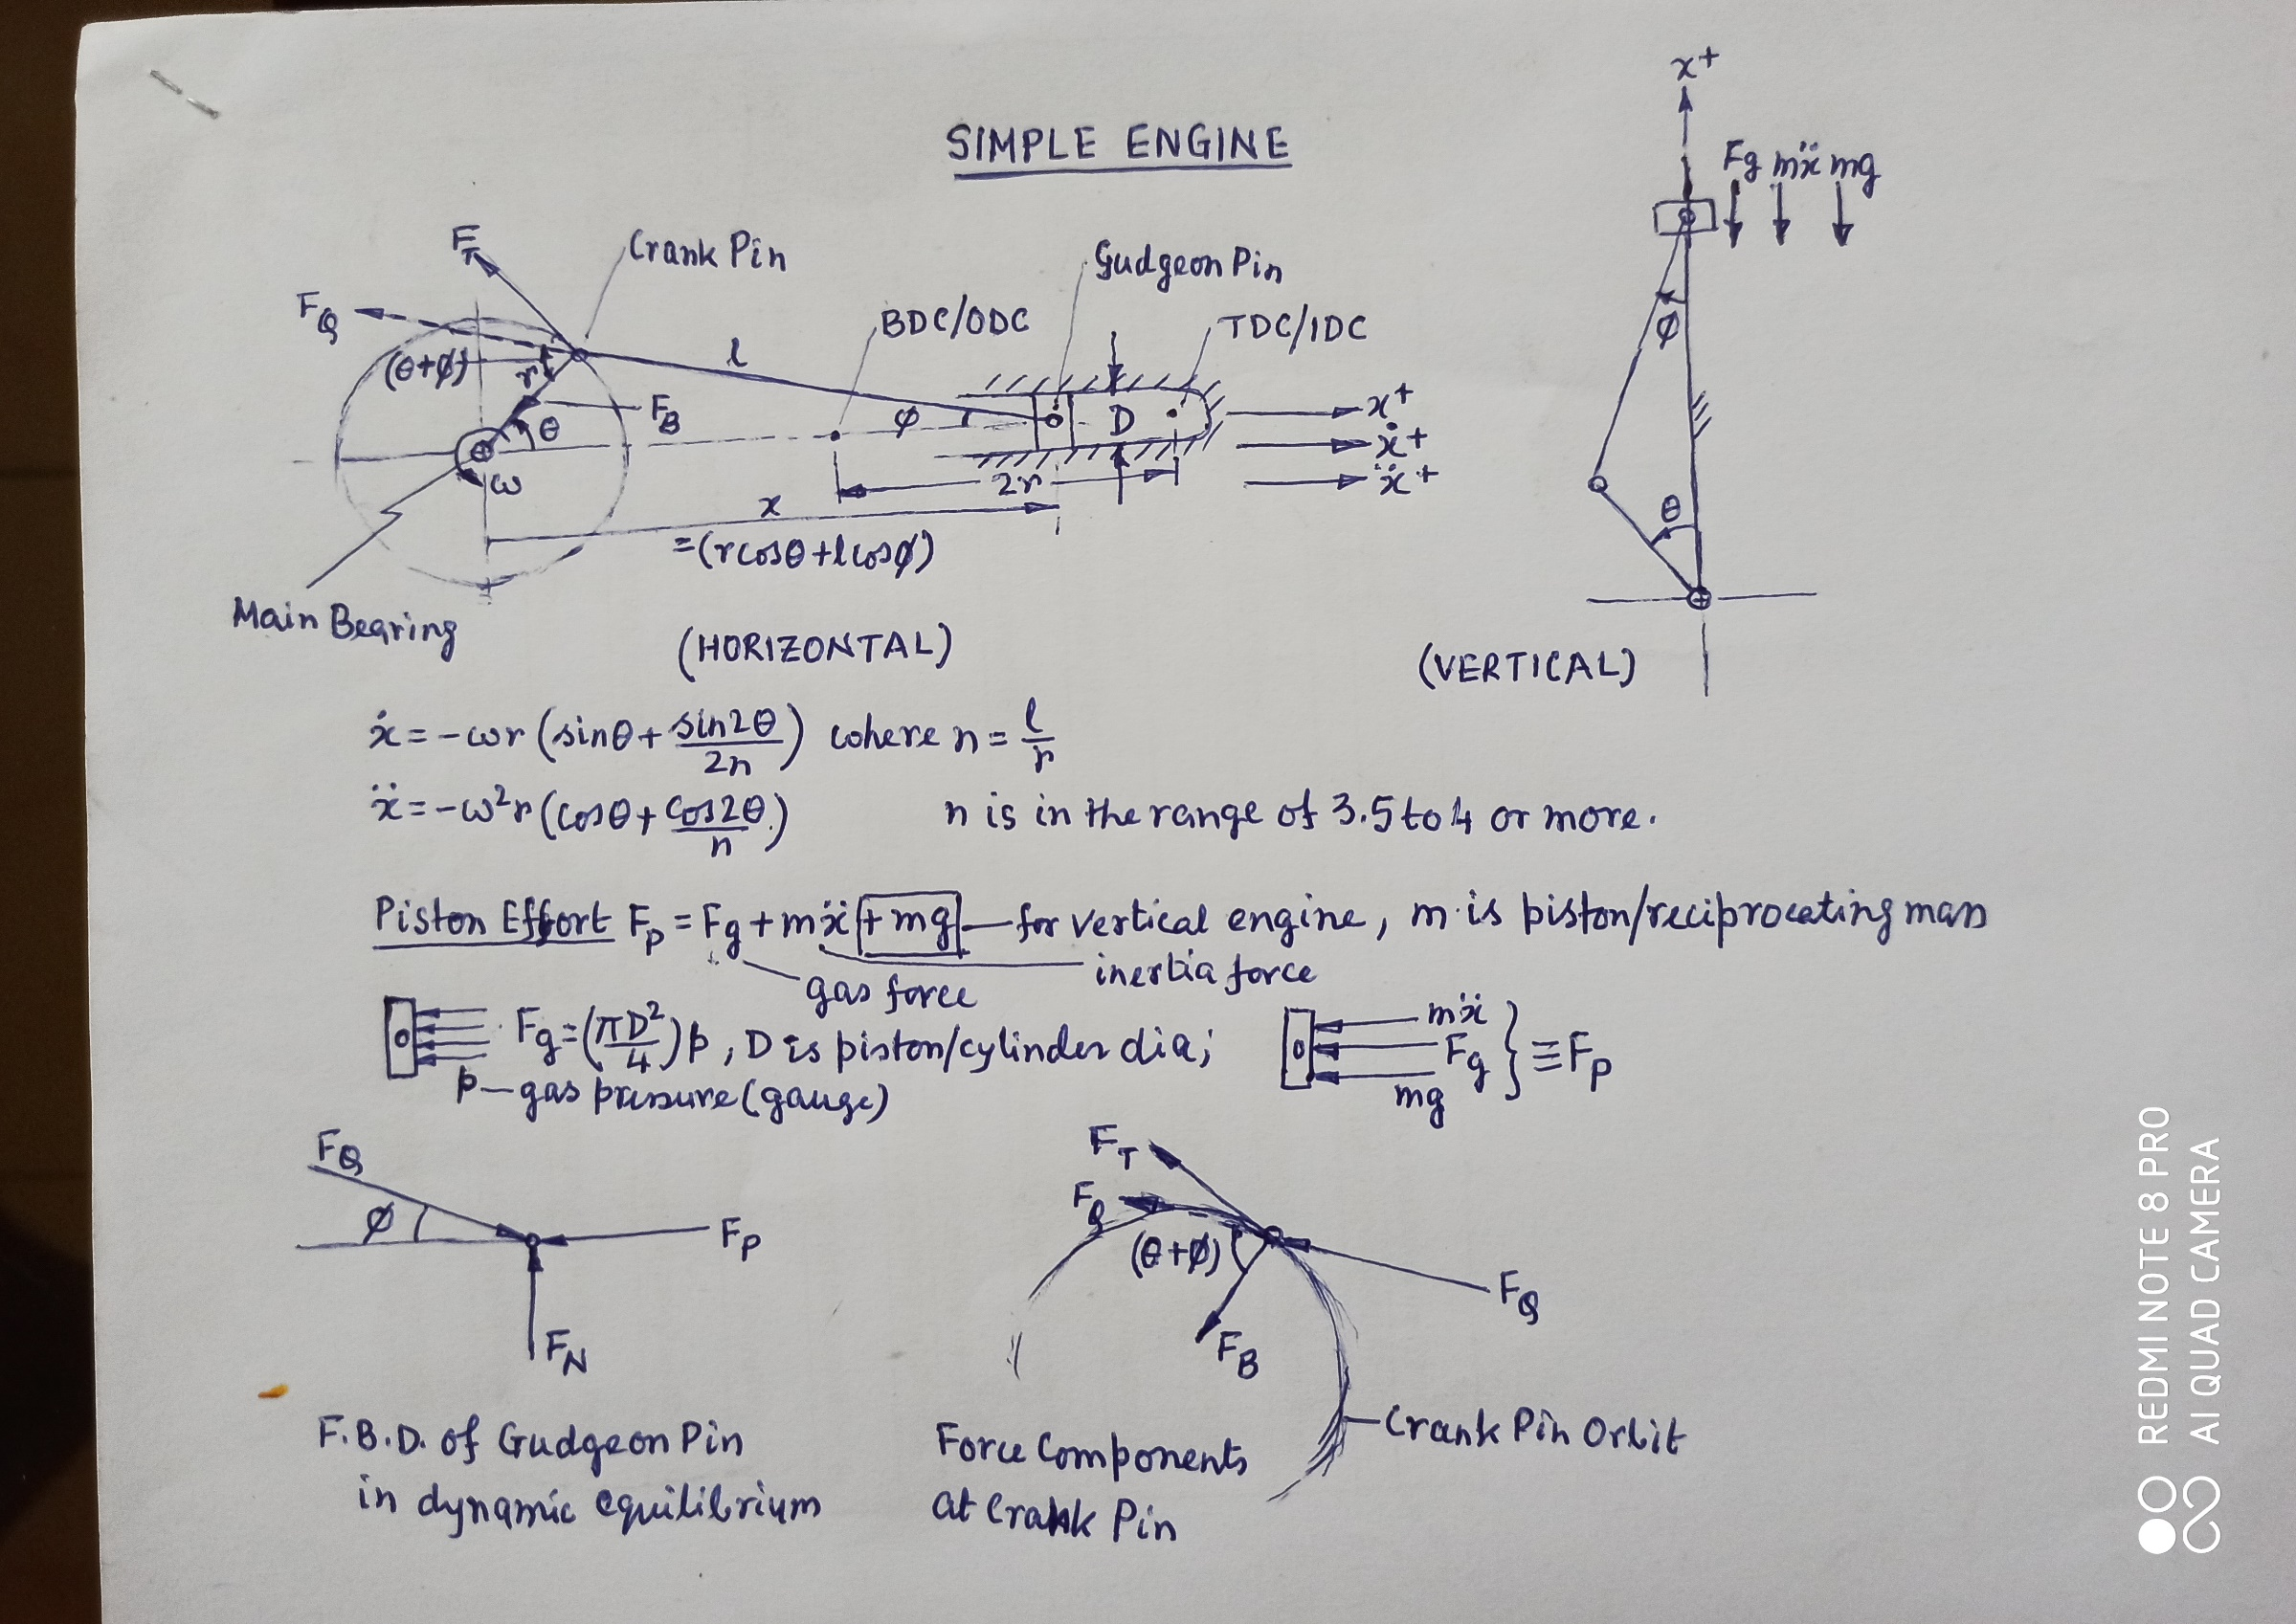
SIMPLE ENGINE MECHANISM

